Slide 1
RESUME PARSING AND ANALYSIS USING JAVA PROGRAMMING
SSBT’s College of Engineering and Technology Bambhori, Jalgaon
Organization Name: MyTech solutions pvt LTD
Address :At Post Dahiwad taluka amalner ,Jalgaon ,425401
Duration of Industrial Training: 6 Month
Manasi Balu Patil
Student
Exam Seat No : 354982
MCA – II Sem-IV (2024-25)
Dr. Dinesh D. Puri
Guide
Head
Department of Computer Applications

Slide 2
Index
Introduction to topic
Hardware and software used
Diagrams - Data flow diagram, Use case diagram, Sequence diagram, Class diagram
Screenshots
Database
Strengths
Limitations
Future scope
Conclusion
References

Slide 3
Introduction to topic
In today’s rapidly evolving job market, both job seekers and employers face a daunting challenge - efficiently sifting through the vast sea of resumes to identify the ideal candidate or job opportunity.
Key features include :-
Role Selection: Users can register as either applicants or recruiters.
* To provide a comprehensive understanding of resume parsing and the challenges associated with it in the modern job market.
* To explore the principles and techniques of Java, and Decision Trees and their suitability for resume analysis.
* To demonstrate the development of a practical application that parses and analyzes resumes using these technologies
* scalability. To evaluate the performance of the system in terms of accuracy, efficiency, and

Slide 4
Hardware and software used
System Required to Develop this Application -
We are using eclipse and neatbean to develop this application and
developing this project on Windows 11 Operating System.
SYSTEM REQUIREMENT SPECIFICATION -
Software Requirements
Operating System: Android 8.0 and above
Hardware Requirements
Processor: 1.2Gz and above
RAM: 1 GB and above
Storage of System: 25 MB and above
1 GB Internal Storage and above

Slide 5
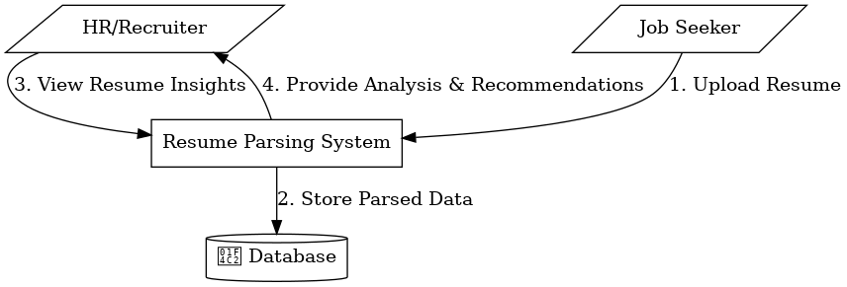
Data flow diagram

Slide 6
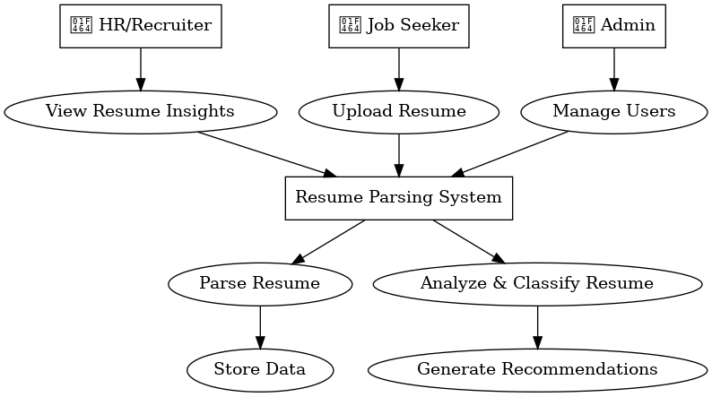
Use case diagram

Slide 7
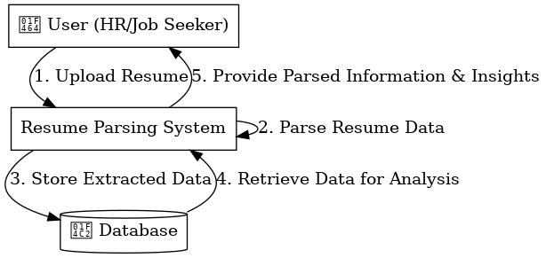
Sequence diagram

Slide 8
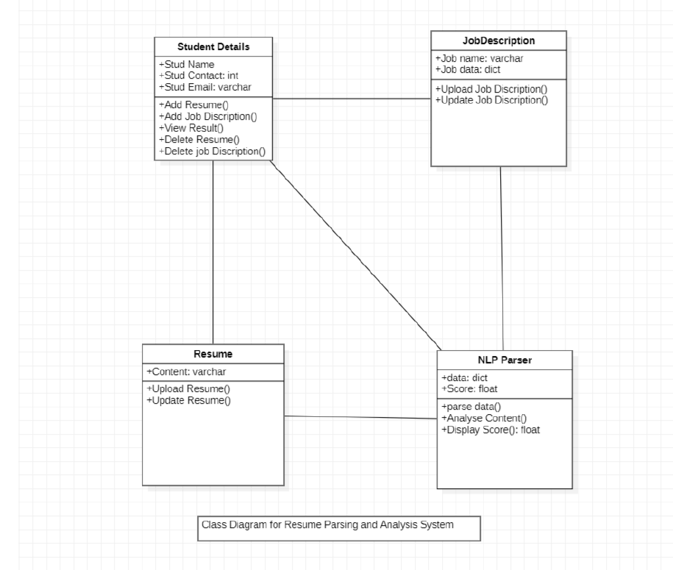
Class diagram

Slide 9
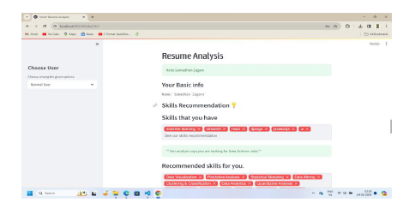
Screenshots

Slide 10
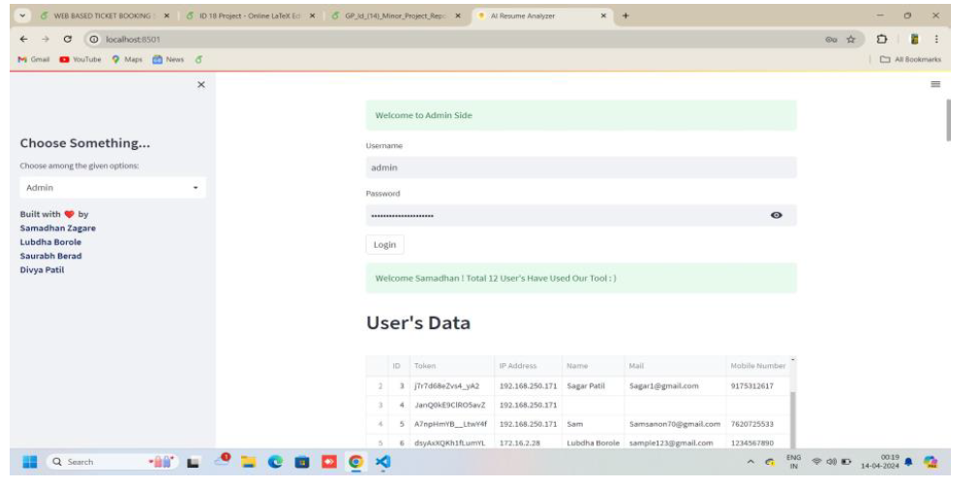
Screenshots

Slide 11

Screenshots

Slide 12
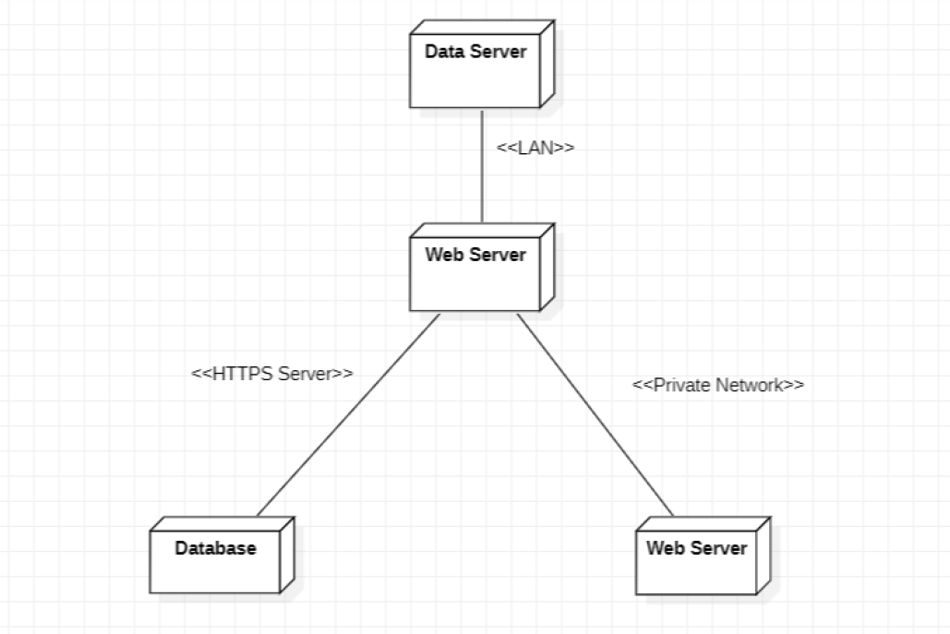
Database

Slide 13
Strengths
Efficiency: The system significantly reduces the time required to manually parse and analyze resumes. It can process large volumes of resumes quickly, allowing HR departments to handle more applications in less time.
Accuracy: By leveraging advanced java techniques, the system can accurately extract relevant information such as work experience, education, skills, and contact details, minimizing human error.
Consistency: The system provides a consistent method of evaluating resumes, eliminating biases and variations that can occur with human reviewers. This consistency ensures fairer candidate evaluations.
.

Slide 14
Limitations
Complex Formatting: Resumes with unconventional formatting, graphics, or layouts can be challenging for the system to parse accurately. This can lead to incomplete or incorrect data extraction.
Context Understanding: The system may struggle with understanding the context of certain information, such as distinguishing between similar job titles or recognizing nuanced differences in skill levels.
Ambiguity in Language: Natural language is inherently ambiguous, and the system may misinterpret or overlook certain phrases, especially if they are colloquial or industry-specific jargon.

Slide 15
Fucture scope
Enhanced Formatting Capabilities: Improving the system's ability to handle various resume formats, including graphical and unconventional layouts, to ensure more comprehensive data extraction.
Advanced Contextual Understanding: Incorporating more sophisticated java models, such as deep learning techniques, to better understand the context and nuances of the language used in resumes. .
Integration with Other Systems: Developing integrations with Applicant Tracking Systems (ATS), HR management software, and other enterprise tools to streamline the recruitment process.

Slide 16
Conclusion
Resume parsing and analysis using java programming represents a significant advancement in the field of recruitment and human resource management. The system offers substantial benefits in terms of efficiency, accuracy, consistency, scalability, and customizability. However, it also faces challenges related to complex formatting, context understanding, language ambiguity, data privacy, and the quality of input data.

Slide 17
References
https://docs.streamlit.io/
https://www.udemy.com/course/the-full-stack-data-scientist-bootcamp/
https://www.ijitee.org/wp-content/uploads/papers/v9i7/F4078049620.pdf
https://www.rchilli.com/blog/resume-parsing-101/

Slide 18
Thank you !

